Slide 1
Syntax Analysis - III

Slide 2
Bottom-up Parsing
LR Parsing
  L means that tokens are read left to right
  R means that it constructs a rightmost derivation
  Also called “Shift-Reduce Parsing”
Find a rightmost derivation in reverse order
LR Grammars
  Can be parsed with an LR Parser
LR Languages
  Can be described with LR Grammar
  Can be parsed with an LR Parser

Slide 3
LR Parsing Techniques
LR Parsing
  Most General Approach
SLR
  Simpler algorithm, but not as general
LALR
  More complex, but saves space

Slide 4
LL vs. LR
LR (shift reduce) is more powerful than LL (predictive parsing)
Can detect a syntactic error as soon as possible.
LR is difficult to do by hand (too much work to done)

Slide 5
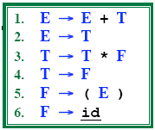
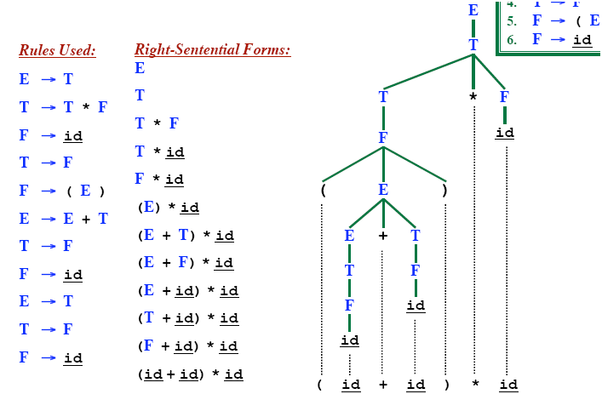
Rightmost Derivation

Slide 6
Shift-Reduce Parsing Rules
Attempts to construct a parse tree for an input string beginning at the leaves and working up towards the root.
A Shift step advances in the input string by one symbol. That shifted symbol becomes a new single-node parse tree.
At each reducing step, a particular substring matching the right side of a production is replaced by the symbol on the left of that production (i.e. a production rule to replace the rule’s RHS with its LHS).
If the substring is chosen correctly at each step, a rightmost derivation is traced out in reverse.

Slide 7
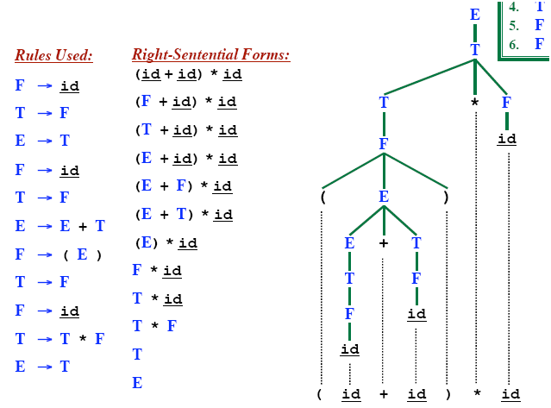
Rightmost Derivation In Reverse
LR parsing corresponds to rightmost derivation in reverse

Slide 8
LR(k) Parsing – Bottom Up
Construct a parse tree from leaves, ‘reducing’ the string to the start symbol (and a single tree).
During parse, we have a ‘forest’ of trees
Shift-reduce parsing
  ‘Shift’ a new input symbol
  ‘Reduce’ a group of symbols to a single non-terminal
  Choice is made using the k look-aheads
LR(1) is also used.

Slide 9
Shift Reduce Parsing
S → a T R e
T → T b c | b
R → d
_{Input String: abbcde}
Rightmost derivation:
S ➔ a T R e
➔ a T d e
➔ a T b c d e
➔ a b b c d e

Slide 10
Shift Reduce Parsing
S → a T R e
T → T b c | b
R → d
_{String : abbcde}
➔
_{Shift a, Shift b}
_{a b}
Rightmost derivation:
S ➔ a T R e
➔ a T d e
➔ a T b c d e
➔ a b b c d e

Slide 11
Shift Reduce Parsing
S → a T R e
T → T b c | b
R → d
_{String : aTbcde}
➔
_{Shift a, Shift b}
_{Reduce T → b}
➔
_{T}
_{a b}
Rightmost derivation:
S ➔ a T R e
➔ a T d e
➔ a T b c d e
➔ a b b c d e

Slide 12
Shift Reduce Parsing
S → a T R e
T → T b c | b
R → d
_{String : ATbcde}
➔
_{Shift a, Shift b}
_{Reduce T → b}
_{Shift b, Shift c}
➔
_{T}
➔
_{a b}
_{b c}
Rightmost derivation:
S ➔ a T R e
➔ a T d e
➔ a T b c d e
➔ a b b c d e

Slide 13
Shift Reduce Parsing
S → a T R e
T → T b c | b
R → d
_{String : ATde}
_{T}
➔
_{Shift a, Shift b}
_{Reduce T → b}
_{Shift b, Shift c}
_{Reduce T → T b c}
➔
_{T}
➔
➔
_{a b}
_{b c}
Rightmost derivation:
S ➔ a T R e
➔ a T d e
➔ a T b c d e
➔ a b b c d e

Slide 14
Shift Reduce Parsing
S → a T R e
T → T b c | b
R → d
_{String : ATde}
_{T}
➔
_{Shift a, Shift b}
_{Reduce T → b}
_{Shift b, Shift c}
_{Reduce T → T b c}
_{Shift d}
➔
_{T}
➔
➔
➔
_{a b}
_{b c}
_{d}
Rightmost derivation:
S ➔ a T R e
➔ a T d e
➔ a T b c d e
➔ a b b c d e

Slide 15
Shift Reduce Parsing
S → a T R e
T → T b c | b
R → d
_{String : ATRe}
_{T}
➔
_{Shift a, Shift b}
_{Reduce T → b}
_{Shift b, Shift c}
_{Reduce T → T b c}
_{Shift d}
_{Reduce R → d}
➔
_{T}
_{R}
➔
➔
➔
_{a b}
_{b c}
_{d}
➔
Rightmost derivation:
S ➔ a T R e
➔ a T d e
➔ a T b c d e
➔ a b b c d e

Slide 16
Shift Reduce Parsing
S → a T R e
T → T b c | b
R → d
_{String: ATRe}
_{T}
➔
_{Shift a, Shift b}
_{Reduce T → b}
_{Shift b, Shift c}
_{Reduce T → T b c}
_{Shift d}
_{Reduce R → d}
_{Shift e}
➔
_{T}
_{R}
➔
➔
➔
_{a b}
_{b c}
_{d}
_{e}
➔
Rightmost derivation:
S ➔ a T R e
➔ a T d e
➔ a T b c d e
➔ a b b c d e
➔

Slide 17
Shift Reduce Parsing
S → a T R e
T → T b c | b
R → d
_{String : S}
_{S}
_{T}
➔
_{Shift a, Shift b}
_{Reduce T → b}
_{Shift b, Shift c}
_{Reduce T → T b c}
_{Shift d}
_{Reduce R → d}
_{Shift e}
_{Reduce S → a T R e}
➔
_{T}
_{R}
➔
➔
➔
_{a b}
_{b c}
_{d}
_{e}
➔
Rightmost derivation:
S ➔ a T R e
➔ a T d e
➔ a T b c d e
➔ a b b c d e
➔
➔

Slide 18
Handle
Informally, a handle is a substring (in the parsing string) that matches the right side of a production rule.
  But not every substring matches the right side of a production rule is handle
A handle of a right sentential form γ (≡ αβω) is
a production rule A → β and a position of γ
where the string β may be found and replaced by A to produce
the previous right-sentential form in a rightmost derivation of γ.
S ⇒ αAω ⇒ αβω
If the grammar is unambiguous, then every right-sentential form of the grammar has exactly one handle.
NOTE: We will see that ω is a string of terminals.
*
rm
rm

Slide 19
Handle Pruning
A right-most derivation in reverse can be obtained by handle-pruning.
S=γ₀ ⇒ γ₁ ⇒ γ₂ ⇒ ... ⇒ γ_{n-1} ⇒ γ_{n}= ω
input string
Start from γ_{n}, find a handle A_{n}→β_{n} in γ_{n}, and replace β_{n} in by A_{n} to get γ_{n-1}.
Then find a handle A_{n-1}→β_{n-1} in γ_{n-1}, and replace β_{n-1} in by A_{n-1} to get γ_{n-2}.
Repeat this, until we reach S.
nth right-sentential form
rm
rm
rm
rm
rm
rm

Slide 20
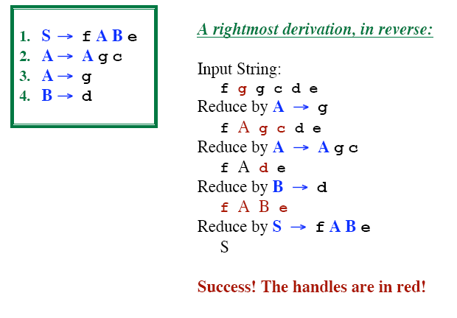
Handles: Example

Slide 21
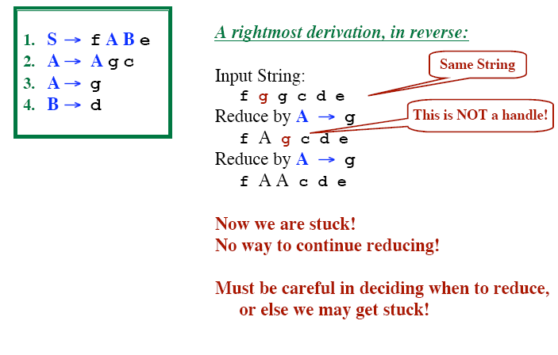
Handles: Example

Slide 22
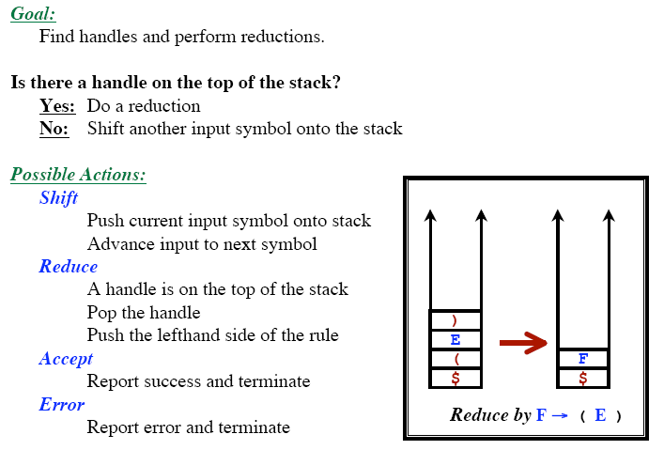
Shift-Reduce Parsing

Slide 23
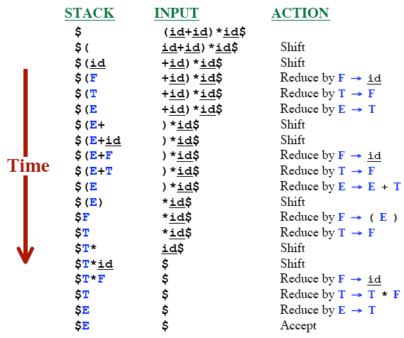
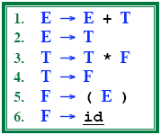
Notation for a Shift-Reduce Execution

Slide 24
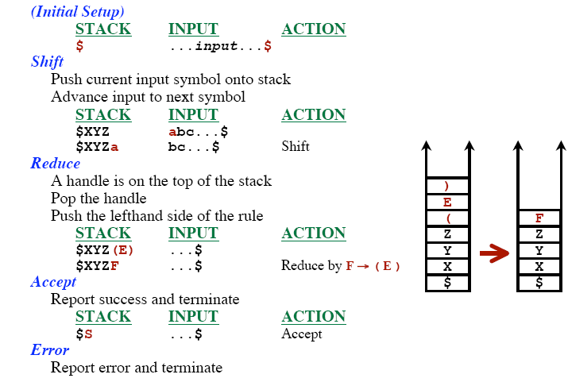
Shift-Reduce Actions

Slide 25
Conflicts During Shift-Reduce Parsing
There are context-free grammars for which shift-reduce parsers cannot be used.
Stack contents and the next input symbol may not decide action:
  shift/reduce conflict: Whether make a shift operation or a reduction.
  reduce/reduce conflict: The parser cannot decide which of several reductions to make.
If a shift-reduce parser cannot be used for a grammar, that grammar is called as non-LR(k) grammar.
left to right right-most k lookhead
scanning derivation
An ambiguous grammar can never be a LR grammar.

Slide 26
Shift-Reduce Conflict in Ambiguous Grammar
stmt → if expr then stmt
| if expr then stmt else stmt
| other
STACK INPUT
….if expr then stmt else….$
We can’t decide whether to shift or reduce?

Slide 27
Reduce-Reduce Conflict in Ambiguous Grammar
stmt → id(parameter_list)
stmt → expr:=expr
parameter_list → parameter_list, parameter
parameter_list → parameter
parameter_list → id
expr → id(expr_list)
expr → id
expr_list → expr_list, expr
expr_list → expr
STACK INPUT
….id ( id , id ) …$
We can’t decide which production will be used to reduce id?

Slide 28
LR Parsing Algorithm
input
a₁ | ... | a_{i} | ... | a_{n} | $
stack
S_{m}
X_{m}
S_{m-1}
X_{m-1}
.
.
S₁
X₁
S₀
LR Parsing Algorithm
output
Action Table terminals and $ s t four different a actions t e s | Goto Table non-terminal s t each item is a a state number t e s
Parsing Table

Slide 29
A Configuration of LR Parsing Algorithm
A configuration of a LR parsing is:
( S_{o} X₁ S₁ ... X_{m} S_{m}, a_{i} a_{i+1} ... a_{n} $ )
Stack Rest of Input
S_{m} and a_{i} decides the parser action by consulting the parsing action table. (Initial Stack contains just S_{o} )
A configuration of a LR parsing represents the right sentential form:
X₁ ... X_{m} a_{i} a_{i+1} ... a_{n} $

Slide 30
Actions of A LR-Parser
shift
If action[S_{m}, a_{i}] = shift s, the parser executes a shift move, entering the configuration
( S_{o} X₁ S₁ ... X_{m} S_{m}, a_{i} a_{i+1} ... a_{n} $ ) ➔ ( S_{o} X₁ S₁ ... X_{m} S_{m} a_{i} s, a_{i+1} ... a_{n} $ )
Here the parser has shifted both the current input symbol a_{i} and the next state s, which is given in action[S_{m}, a_{i}], onto the stack; a_{i+1} becomes the current input symbol.
reduce
If action[S_{m}, a_{i}] = A→β then the parser executes a reduce move, entering the configuration
( S_{o} X₁ S₁ ... X_{m} S_{m}, a_{i} a_{i+1} ... a_{n} $ ) ➔ ( S_{o} X₁ S₁ ... X_{m-r} S_{m-r} A s, a_{i} ... a_{n} $ )
  where s = goto[S_{m-r}, A] and r is the length of β, the right side of the production.
  The parser first popped 2r symbols off the stack, exposing state S_{m-r}. The parser then pushed both A, the left side of the production, and s, the entry for goto [s_{m-r}, A], onto the stack.
  Output is the reducing production reduce A→β

Slide 31
Actions of A LR-Parser (continued)
Accept – Parsing successfully completed
Error -- Parser detected an error (an empty entry in the action table)

Slide 32
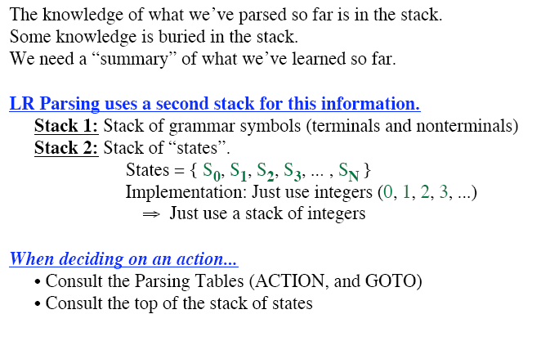
LR Parser Stack(s)

Slide 33
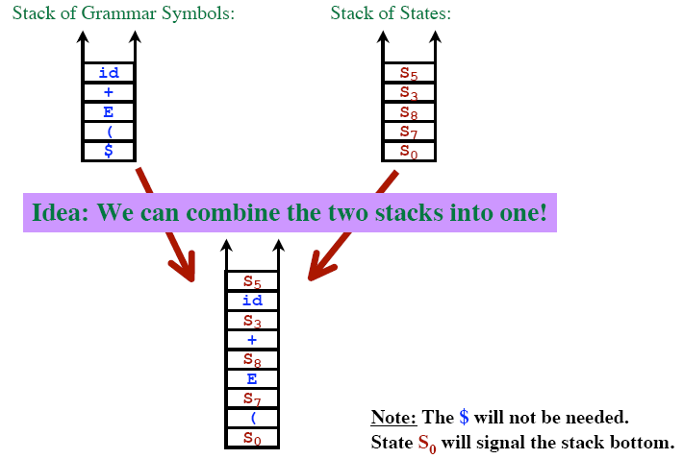
The Stack of States

Slide 34
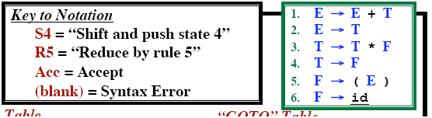
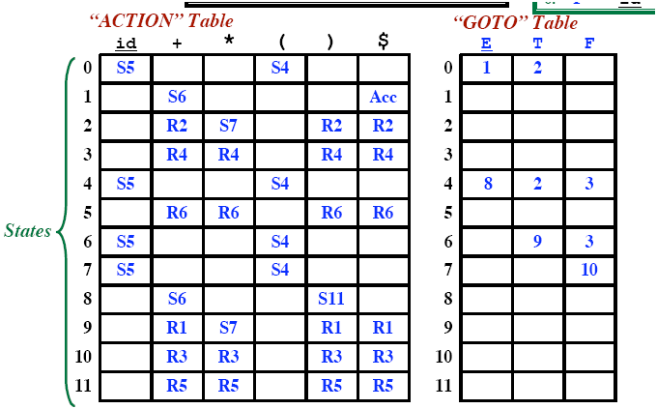
The Stack of States
3

Slide 35

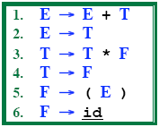
Example LR Parse: (id+id)*id

Slide 36

Example LR Parse: (id+id)*id

Slide 37
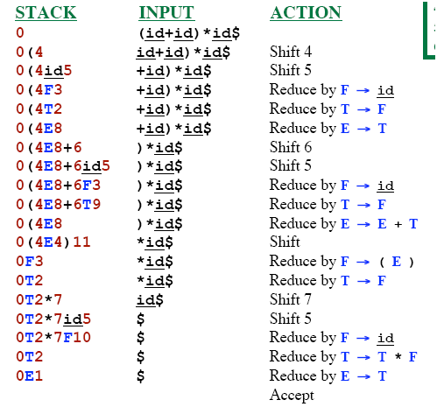
Example LR Parse: (id+id)*id

Slide 38
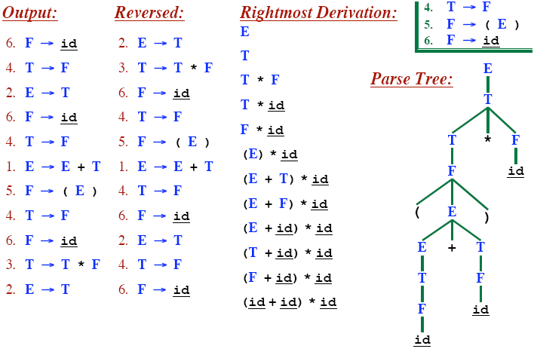
Example LR Parse: (id+id)*id

Slide 39
Actions of an LR-Parser -- Example
stack input action output
0 id*id+id$ shift 5
0id5 *id+id$ reduce by F→id F→id
0F3 *id+id$ reduce by T→F T→F
0T2 *id+id$ shift 7
0T2*7 id+id$ shift 5
0T2*7id5 +id$ reduce by F→id F→id
0T2*7F10 +id$ reduce by T→T*F T→T*F
0T2 +id$ reduce by E→T E→T
0E1 +id$ shift 6
0E1+6 id$ shift 5
0E1+6id5 $ reduce by F→id F→id
0E1+6F3 $ reduce by T→F T→F
0E1+6T9 $ reduce by E→E+T E→E+T
0E1 $ accept

Slide 40
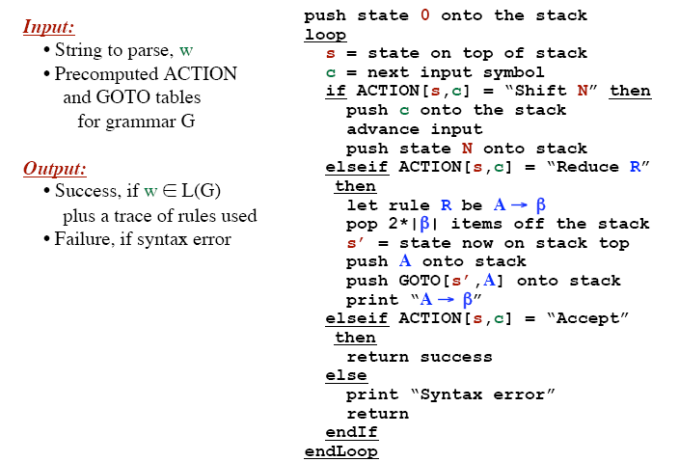
LR Parsing Algorithm

Slide 41
LR Parsing Algorithm
The symbol a_{i} are not to be held on the stack
  It can be recovered from the state s if needed (never needed in practice)
A configuration of an LR parser
(S₀ S₁ … S_{m}, a_{i} a_{i+1} …. a_{n}$)
represents the corresponding right sentential form
X₁ X₂ … X_{m} a_{i} a_{i+1} … a_{n}
Essentially similar to shift-reduce parsers
  Instead of grammar symbol the stack holds states from which grammar symbols can be recovered
  S₀ does not represents a grammar symbol rather bottom-of stack marker
Stack contents
remaining input

Slide 42
Modified LR Parsing Algorithm

Slide 43
Actions of an LR-Parser – New Version
stack input action output
0 id*id+id$ shift 5
0 5 *id+id$ reduce by F→id F→id
0 3 *id+id$ reduce by T→F T→F
0 2 *id+id$ shift 7
0 2 7 id+id$ shift 5
0 2 7 5 +id$ reduce by F→id F→id
0 2 7 10 +id$ reduce by T→T*F T→T*F
0 2 +id$ reduce by E→T E→T
0 1 +id$ shift 6
0 1 6 id$ shift 5
0 1 6 5 $ reduce by F→id F→id
0 1 6 3 $ reduce by T→F T→F
0 1 6 9 $ reduce by E→E+T E→E+T
0 1 $ accept

